Slide 1
Upload Client Developing
-- Introduction --

Slide 2
Guideline
Upload Frame (CP, VM, FT, WAT, Bump);
Upload_Client to Daemon for Windows
Upload Data (TPAS STANDARD FORMAT);
Windows, Rlease procedure
Program Upload Client (Versa Case-- Versa for PE in BackUp PGM)
Trouble Shooting for Error in Daemon

Slide 3
Guideline (2)
Upload Frame for Unix
Introduction for Unix Tester Enviroment and Data
Release Procedure of Upload Program for Unix (ksh, daemon)
Program Java Upload Client (HP93K 313 case);
Program Perl Upload Client (change daemon case)

Slide 4






Upload Architecture
■ Dispatching
Daemon(s)
Factory Work
Planning
■
Upload Clients
DB Server
1
IBM
AsmView
KSUP
4
MES
2
WebRPC
■ AP Server
5
3
JDBC
TPAS
POLO
TPAS
Upload Deamon
( KSite => KSUP1, 2
TSite => POLOI, II
SGSite => SGUP1, 2)
  ‧Transmitter for Testing
  ‧Convert formats
  ( Cust formats <- > Std formats )
Data Collecting
and Processing

Slide 5


Test Data Upload Flow
Archive Server
MES
Retrieve PGM, Device, Probe card,
…information from database
(PGM, EC, Fixture management)
TPAS
Lot Start
Success
TESTER
Upload System
lot_control
-c
(upload parameter)
Waf_trans.exe
Upload_Cleint
Upload EJB
Load PGM
ASCII wafer
Data
Zip wafer Data
(*.RAWMAP,
*.BINSUM, ...)
Fail
Alert Message
Reject Pool (KSUP1, KSUP2)
Dispatching
Daemon
Jane @ADT 07’/08/01

Slide 6

VM/Bump Data Upload Flow
■ Customer FTP
■ get by perl pgm
■ Ardentec FTP
■ Upload by perl pgm
ftp_XXX_get.pl
ftp_XXX_put.pl
.xml
–f[filePath].dat
–f[filePath].dat
.xml
■ Package Zip file
■ Daemon Server
■ TPAS DB
map.info
.xmldefect
.binsum
boxter

Slide 7
Upload Client Overview
■ Tester Upload pgm
■ Upload Client
■ Package Zip file
waf_trans.exe
map.info
Kalos_Main
A_Kalos_CP.properties
.bin
.binsum
Kalos
-c[cust_id] –k[wafer_id].bin
.map
.rawmap
.map
.ra
.rawra
.ra
.sum
.sum
.bin
waf_trans (UploadClient.pl)
map.info
Versa_Main
C_Versa_CP.properties
.binsum
Versa
.map
.rawmap
–c[cust_id] –p[prdgrp_id] –f[file_name]
.ra
.rawra
.map
.ra
Waf_trans (UploadClient.pl)
■ Daemon Server
T5335P
.binsum
[prdgrp_id] [wafer_id] [vers.]
T5335P_Main
C_T53359_XXX_CP.properties
jnl.
o.
o.
jnl.

Slide 8
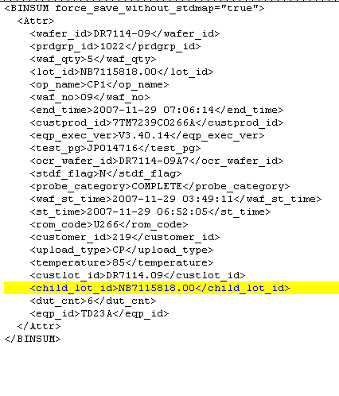
TPAS STANDARD FORMAT
-- BinSum File --
需要處理CP的rawdata info有下列幾種值(attribute):
Notes:
範本:
<st_time></st_time>
<customer_id></customer_id>
<ocr_wafer_id></ocr_wafer_id>
<end_time></end_time>
<wst_time></wst_time>
<eqp_id></eqp_id>
<temperature></temperature>
<wafer_id></wafer_id>
<test_pg></test_pg>
<upload_type></upload_type>
<waf_no></waf_no>
<claim_user_id></claim_user_id>
<dut_cnt></dut_cnt>

Slide 9
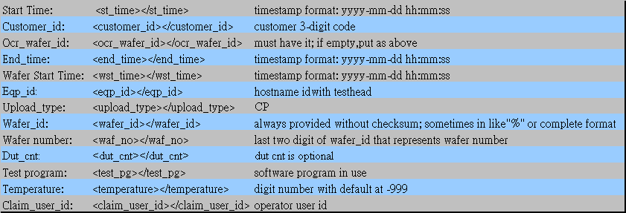
TPAS STANDARD FORMAT
-- BinSum Attribute (CP) --
需要處理CP的rawdata info有下列幾種值(attribute):
Notes:
範本:
<st_time></st_time>
<customer_id></customer_id>
<ocr_wafer_id></ocr_wafer_id>
<end_time></end_time>
<wst_time></wst_time>
<eqp_id></eqp_id>
<temperature></temperature>
<wafer_id></wafer_id>
<test_pg></test_pg>
<upload_type></upload_type>
<waf_no></waf_no>
<claim_user_id></claim_user_id>
<dut_cnt></dut_cnt>

Slide 10
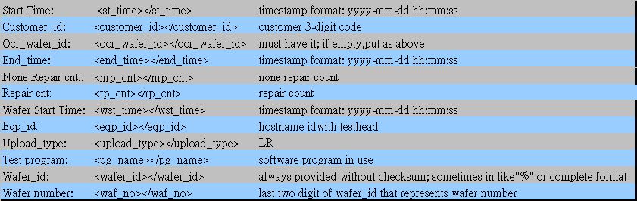
TPAS STANDARD FORMAT
-- BinSum Attribute(LR) --
需要處理LR的rawdata info有下列幾種值(attribute):
LR attribute有下列幾個與CP稍有差異:
  無tag <temperature>及<claim_user_id>
  多了tag<nrp_cnt>及<rp_cnt>
  Test program: <pg_name></pg_name>
  Upload_type: LR
Notes:
範本:
<customer_id></customer_id>
<st_time></st_time>
<ocr_wafer_id></ocr_wafer_id>
<pg_name></pg_name>
<end_time></end_time>
<nrp_cnt></nrp_cnt>
<wst_time></wst_time>
<rp_cnt></rp_cnt>
<eqp_id></eqp_id>
<upload_type></upload_type>
<wafer_id></wafer_id>
<waf_no></waf_no>

Slide 11
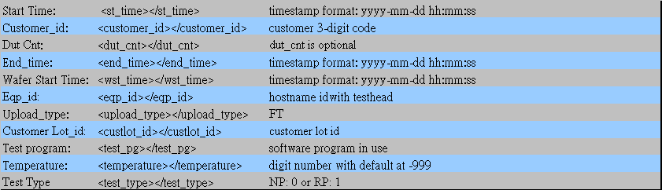
TPAS STANDARD FORMAT
-- BinSum Attribute(FT) --
需要處理FT的rawdata info有下列幾種值(attribute):
FT attribute有下列幾個與CP稍有差異:
  無tag<orc_wafer_id>,<claim_user_id>,<wafer_id>,<waf_no>
  Test type: <test_type></test_type>
  Upload_type: FT
Notes:
範本:
<st_time></st_time>
<customer_id></customer_id>
<end_time></end_time>
<dut_cnt></dut_cnt>
<test_type></test_type>
<wst_time></wst_time>
<custlot_id></custlot_id>
<temperature></temperature>
<eqp_id></eqp_id>
<test_pg></test_pg>
<upload_type></upload_type>

Slide 12
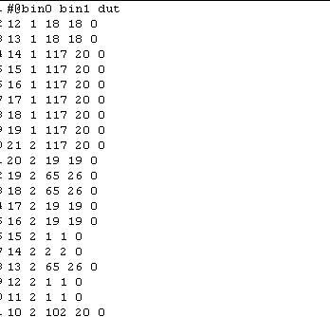
TPAS STANDARD FORMAT
-- RAW MAP --

Slide 13


Upload Client System
■ Machine Level
■ Server Level
Dispatching Daemon
UNIX
UNIX Testers
Upload
Perl
INBOX
XML
Upload
Client
UNIX
Upload
Perl
TPAS
RAW
REJECT
QUEUE
WIN
NT Testers
Upload
Client
Others
WIN
Upload
Client
Files Waiting for
Upload to TPAS
Converting formats
( Custom formats
<- > Standard formats )

Slide 14
Upload Clients
-- Introduction --
Upload testing data from Testers to Dispatching Daemons.
  Provides standard API for customization
  Two languages types are provided
    Java
    Perl
  Transmitter for Testing Equipments
    Provides Java, Perl package for different platforms
Upload client converts test data format and feed to Daemon ( Custom formats <- > Standard formats )

Slide 15
Upload Framework
NT
UNIX
UploadClient
MACHINE
Level
Java Client
Java Client
Dispatching Daemon
SERVER
Level
TPAS

Slide 16
Upload Framework
-- Client Config for Common --
biz.tpas.uploadclient.log.MailHandler.level: mail handler
biz.smas.util.log.output.ConsoleHandler.level: console handler
biz.tpas.uploadclient.log.UploadLogFileHandler.upload_type: CP/FT/LR
biz.tpas.uploadclient.log.UploadLogFileHandler.upload_type = CP
biz.smas.util.log.output.ConsoleHandler.level = WARNING
biz.smas.util.log.output.ConsoleHandler.formatter = biz.tpas.uploadclient.log.LogFormatter
biz.tpas.uploadclient.log.MailHandler.level = ERROR
UploadLogProp.properties

Slide 17
Upload Framework
-- Client Config for Common --
[eqp_name].properties:
customer.[cust_id].cp.client.loader: load specified class
clearFile.flag: recursive clear file boolean
clearDay.default: days for archived files to remain on server
Sample:
customer.default.cp.client.loader=biz.tpas.uploadclient.j750.cp.A_J750_Client
customer.default.ft.client.loader=biz.tpas.uploadclient.j750.ft.A_J750_Client
clearFile.flag= false
clearDay.default=5
J750.properties

Slide 18
Upload Framework
-- Java Client for NT--
CmdArgParser
UploadClient
Argument parsing
A_[host_name]_CmdArgParser
PropBundle
A_[host_name]_Client
Property retrieve
A_[host_name]_Bundle
TransformFactory
Create binsum/rawmap/rawra processor
A_[host_name]_TransFactory
BinSumProcessor
A_[host_name]_BinSum
Binsum parsing

Slide 19
Upload Client Architecture
-- Client Config for NT--
Sample:
customer.default.data=HB:1 SB:0
customer.159.data=HB:0 SB:1
customer.140.data=HB:0 SB:1
customer.105.data=HB:0 SB:1
customer.default.rawmap.meta=bin0 bin1
filename.format= .sum .bin .map
A_J750_CP.properties
A/C_[eqp_name]_[cust_id]_CP/FT.properties(NT)
customer.[cust_id/prdgrp_id].rawmap.meta
  Bin_types to be included-size countable
customer.[cust_id].data
  Software bin/hardward bin distinction
filename.format
  File extension

Slide 20
Upload Client Architecture
-- Client Logfile --
CONF: biz.tpas.uploadclient.log.UploadLogFileHandler.output_dir
UNIX:
Logfile format: [upload_type]_[yyyymm].log
On Machine: ~prjmgr/upload/logfile
On Daemon: ~loader followed by CONF
NT:
Logfile format: [upload_type]_[host]_[yyyymm].log
On Machine: ‘\\ipstore1\*data\TpasLog\LogFiles\’ followed by CONF

Slide 21
Upload Framework
-- Perl & Java Client for UNIX--
UploadClient
Java Client
/data1/[prdgrp_id]
/daemon/rawfiles/[host_name]
PERL path=~ /usr/local/bin/perl
Triggered By:
waf_trans -c[cust_id] -p[prdgrp_id] -f[filename]
waf_trans -c[cust_id] -p[prdgrp_id] -l[custlot_id] -w[waf_no] -o[op_name] -h[test_head]
Need Conf files to locate raw files
Require FTP_UTIL.pm, TELNET_UTIL.pm, CONF_UTIL.pm under ./perl

Slide 22
Upload Framework
-- Client Configuration for UNIX--
Sample:
customer.default.rawmap.meta=bin0 NONE
filename.default.format= .asc
filetitle.CP1.format= u r j
filetitle.CP2.format= s c l
filetitle.CP3.format= a k l
filetitle.CP4.format= m n l
file.default.subdir= wafermap rafile vbbmap
destrawfile.CP1.ext=map ra vbb
destrawfile.CP2.ext=map . vbb
destrawfile.CP3.ext=map . vbb
C_T5335P_202_CP.properties
A/C_[eqp_name]_[cust_id]_CP/FT.properties (UNIX)
customer.[cust_id/prdgrp_id].rawmap.meta
  Bin_types to be included-size countable
file.[op_name].subdir
  Directory for locating raw files
filetitle.[op_name].format
  File search rule
destrawfile.[op_name].ext
  Raw files with renamed extension
subexttitle.[op_name].format
  Optional raw files with unique extension (187)
subgrptitle.[op_name].[prdgrp_id].format
  Optional raw files with unique subtitles (113)

Slide 23
Upload Framework
-- UPLOAD Program Release --
UNIX:
Release Server: R101
Source: ~R101/TPAS
Release Conf: UploadConf
Release Perl: UploadPerlTJ,UploadPerlTU
Release waf_trans/ft_trans: UploadWafTrans,UploadFtTrans
Release Source: UploadPerlSrc
Release perl module: UploadPerlMod
NT:
Release Server: ‘\\ipstore1’
Source: ~ipstore1\NTPGM\cim\TPAS\UploadClient\bin\

Slide 24
Upload Client Case Study
-- J750 Delay Mode Upload--
UPLOAD_MODE: PARTIAL_RT/PARTIAL/ABORT/COMPLETE
-PROGRAM: HC573E_PB_05.xls
-JOB_NAME: CP1
-CUSTOMER_ID: 159
-TESTER: TD16A
-PROBER: PD16A
-PROBECARD: 0687-1-01 3
-CUST_LOT_NO: A45KPV.1
-ADT_LOT_NO: NB4070946.00
-WAFER_ID: MP1736854071F1
-OPERATOR: A0940
-TEMPERATURE: 28.1
-Start_Time: 2004-07-28-09.29.29
-End_Time: 2004-07-28-09.30.05
-Site_Count: 4
-ProberCFG: HCMOSX4
-Total_Test: 256 Dies
[BIN_LIST_BEGIN]
X Y HB SB DutNo T_Num
=========================================================
40 49 1 1 2 150
41 48 1 1 3 150
45 51 1 1 0 150
46 50 1 1 1 150
47 49 1 1 2 150
48 48 1 1 3 150
56 45 1 1 0 150
57 44 1 1 1 150
58 43 1 1 2 150
59 42 1 1 3 150
Bin File Format:
Delay Probe HS can show partial/complete data uploaded at different times. Data Monitor can trace each map output recorded by each time frame inside DCLOG function.
Delay Probe HS mechanism will be released no later than 08/15. In the meantime, DCLOG will support other uploaded data in delay mode.
Upload is invoked by testPgm every 20 mins
TPAS Data Management Tool: merge_flag=3
DCLog: end_time attributes for each upload sequence

Slide 25
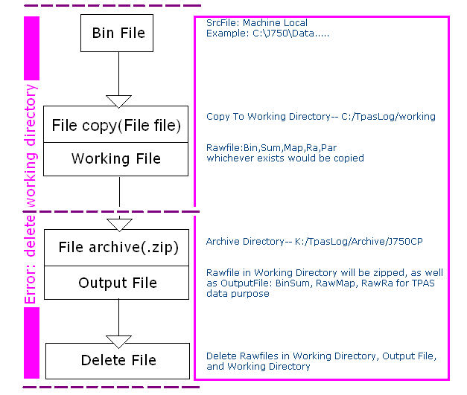
Upload Client Case Study
-- J750 Upload Mode Change --
Cause: Samba open file lock for Java program
Action: Change current environment on ipstor3:NTPGM to local machine
Implementation Date: November 04, 2004
Possible network failure points:
1st - before the upload program is invoked by local test program;
2nd - during file being copied to Ipstor3, K:;
3rd - at pinging daemon server.
Unexpected Error Handling:
1. 1st - archive directory changed from ipstore to local machine to prevent 2nd point
2. 2nd - re-archive directory created to prevent 3rd point
** overall .bin file can always be uploaded in appended format

Slide 26
Upload Client Case Study
-- J750 Upload Mode- cont. --
J750 Programs:
./bin: main parsing programs
./conf: configuration definition
./biz/tpas/uploadclient/net: fdp connect tool
./biz/tpas/uploadclient/log: log & mail function
./biz/tpas/uploadclient/util:
RawMapRow: add RawMap arraylist
TextFormat: change time & text datatype
MailMessage : mail function
FileUtil : copy/delete/move function
ClearFileThread: clear dir defined in conf.
Current environment:
Ipstor3:NTPGM\CIM\Tpas\program
Classpath:
C:\CIM\TPAS\Program;
C:\CIM\TPAS\Program\conf\conf.zip;
C:\CIM\TPAS\Program\bin\upload.zip;
C:\CIM\TPAS\Lib\tpaslib.jar;
C:\CIM\TPAS\Lib\j2ee.jar;
Trigger Command:
JWafTrans.cmd ➔ J750WafTrans.cmd

Slide 27
Upload Client Case Study
-- J750 Delay Mode --
// Case 1: Try To Merge Wafer For Delay Probe
if (!"PARTIAL_RT".equalsIgnoreCase(probe_category))
{
retObj = executeMergeWaferForDelayProbe(user, lot_id, op_name, wafer_id, rwk_flag);
  if (retObj != null)
  return retObj;
}
// Case 2: Try To Merge Wafer For Fail RT
if (rwk_flag > 0)
{
if ("PARTIAL_RT".equalsIgnoreCase(probe_category))
{
  retObj = executeMergeWaferForFailRt(user, lot_id, op_name, wafer_id, rwk_flag);
  if (retObj != null)
  return retObj;
}

Slide 28
Upload Client System
■ Machine Level
■ Server Level
Dispatching Daemon
UNIX
UNIX Testers
Files
Waiting
to Upload
Upload
Perl
INBOX
XML
Upload
Client
UNIX
Upload
Perl
TPAS
REJECT
QUEUE
RAW
WIN
NT Testers
Upload
Client
Others
WIN
Upload
Client
Store Upload
Fail Files
Converting formats
( Custom formats
<- > Standard formats )

Slide 29
Upload Framework
-- Dispatching Deamon --
‧Server
-- TSite: POLOI/POLOII
-- KSite: KSUP1/KSUP2
-- SGSite SGUP1
-- Test Server: VISION
CONFIG: /daemon/DispatchingDaemon/apps/dispd/SAR-INF/config.xml
<server>
<host>172.28.14.6</host>
<port>80</port>
</server>
START: /daemon/DispatchingDaemon/bin/phoenix.sh start
STOP: /daemon/DispatchingDaemon/bin/phoenix.sh stop

Slide 30
Upload Framework
-- Deamon Config --
PATH under
/daemon/DispatchingDaemon/apps/dispd/SAR-INF/config.xml
Important configs
  folder
  file storing PATH
  TPAS
    server priority
    TPAS hostname and port.
  Workers Concurrent Thread for Daemon to TPAS

Slide 31
Upload Framework
-- Deamon File Folder --
Upload ZIP File: [lot_id]_[wafer_id]_[current date].zip
Knowing Daemon directory structures
  INCOMING: /daemon/queues/inbox
  All tester’s uploaded testing data will temporary queued in here.
  REJECT: /daemon/queues/reject
  If test data upload to TPAS failed, will move to this reject directory.
  -- ARCHIVE: /daemon/queues/archive/[prdgrp_id]/[op_name]
  All upload files will be zipped and stored by ADT Prdgrp and OP stage on lancer after uploading.

Slide 32
Upload Framework
-- Daemon LOGS --
It means priority to send to TPAS servers.
  For example
  <TPAS>
  <server priority="1">
  <host>TSTPAS1</host>
  <port>80</port>
  </server>
  <server priority= 3">
  <host>TSTPAS2</host>
  <port>80</port>
  </server>
  <TPAS>
Daemon Logs
Path:
  Named as daemon-yyyymmdd.log

Slide 33
Upload Client System
■ Machine Level
■ Server Level
Dispatching Daemon
UNIX
UNIX Testers
Files
Waiting
to Upload
Upload
Perl
INBOX
XML
Upload
Client
UNIX
Upload
Perl
TPAS
REJECT
QUEUE
RAW
WIN
NT Testers
Upload
Client
Others
WIN
Upload
Client
Store Upload
Fail Files
Converting formats
( Custom formats
<- > Standard formats )

Slide 34
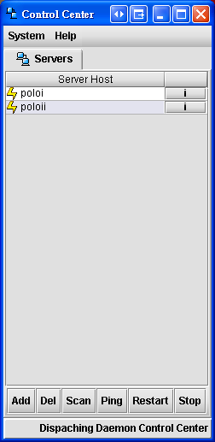
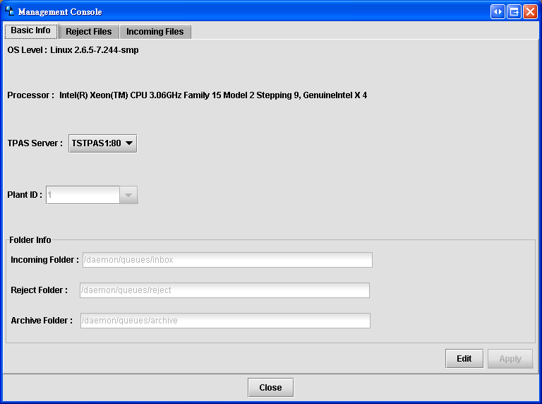
UPLOAD STATUS CHECK
-- Daemon Console --
Reject/Incoming
Select Daemon Server

Slide 35
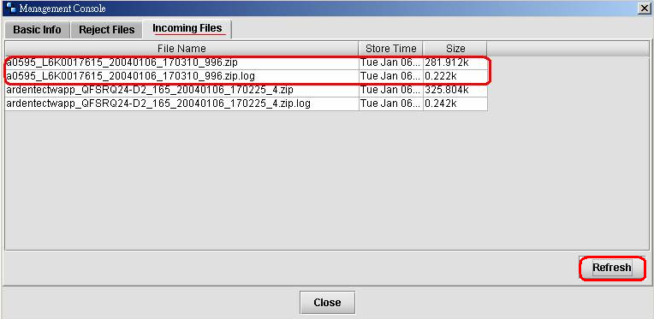
UPLOAD STATUS CHECK
-- Incoming Folder --
‧Incoming Folder存放著來自於機台正要被處理的資料
  ‧按Refresh鍵即可看到正在上傳的.zip檔案
  ‧命名模式:[hostname]_[custlot_id+waf_no]_[timestamp].zip

Slide 36
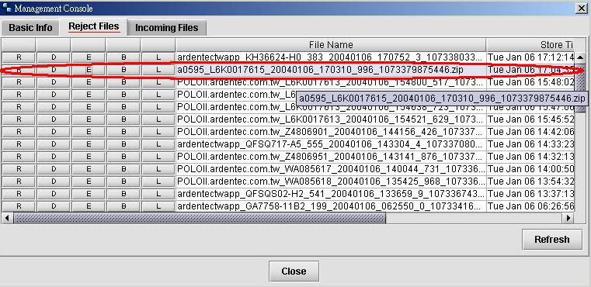
UPLOAD STATUS CHECK
-- Reject Folder --
  Reject Files底下則是存放rawfile本身在upload的情況就有了問題的檔案

Slide 37
UPLOAD STATUS CHECK
-- Reject F.按鍵功能 --
針對Raw file本身的問題
有幾個較常發現的狀況可以使用按鍵當下解決
R: Redo file
D: Delete file
E: Error code
B: Rawdata information(ex. eqp_id, wafer_id, start_time,end_time) in .BINSUM file
L: log information(ex. client host)

Slide 38
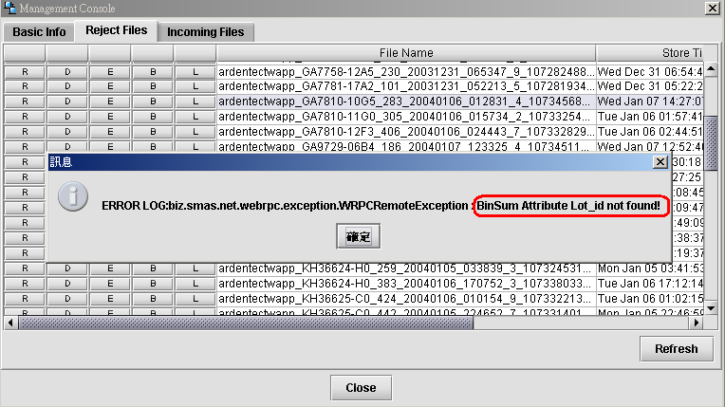
UPLOAD ERROR HANDLE
-- BinSum Attribute Not Found--
ENG上傳模式可以套用Attribute以直接編輯.BINSUM來上傳資料,主要是編輯MES INFO方面的資料以供程式作為判斷批號的依據

Slide 39
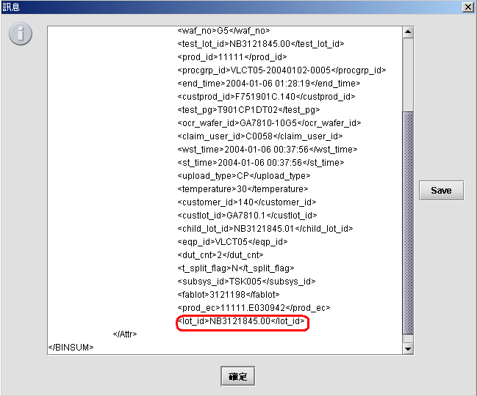
UPLOAD ERROR HANDLE
-- BinSum Attribute Usage --
新增名字為lot_id的tag: <lot_id></lot_id>
SAVE過後即按R鍵重新上傳

Slide 40
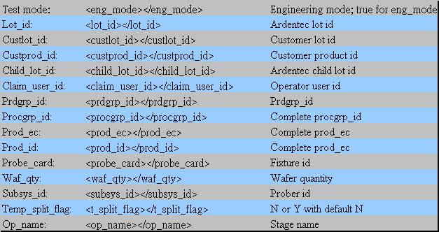
UPLOAD STATUS CHECK
-- BinSum Attribute Usage (Others) --
需要處理的MES info有下列幾個值(attribute):
注意:如果一開始為CP/LR Production Mode改至Engineering Mode,在SAVE檔案之前務必檢查Wafer id及Wafer no,請將有帶checksum的wafer id移除並修正原本waf no為 checksum的wafer;有些wafer會帶有%的符號,也請修正為正確的wafer id

Slide 41
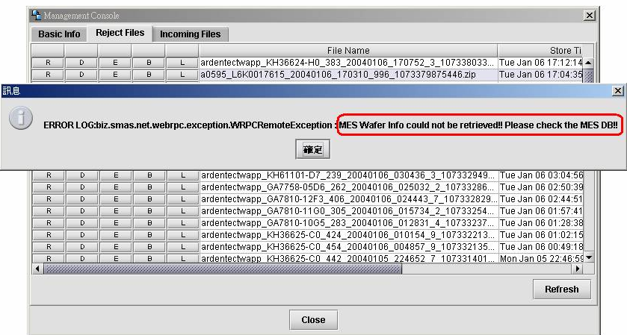
UPLOAD ERROR HANDLE
-- MES INFO. Not Found (CP) --
ERROR LOG: ...MES Wafer Info could not be retrieved!! Please check the MES DB!!
原因:未過帳或過帳時間與Wafer測試時間不一致
方式:ENG模式上傳 (或是參照編輯.BinSum檔案)

Slide 42
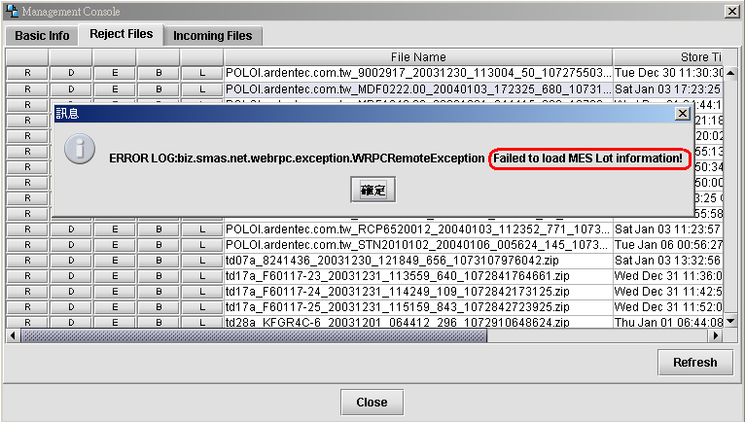
UPLOAD ERROR HANDLE
-- MES INFO. Not Found (FT) --
ERROR LOG: ...Failed to load MES Lot information!(for FT)
原因:未過帳或過帳時間與Wafer測試時間不一致
方式:ENG模式上傳 (或是參照編輯.BinSum檔案)

Slide 43
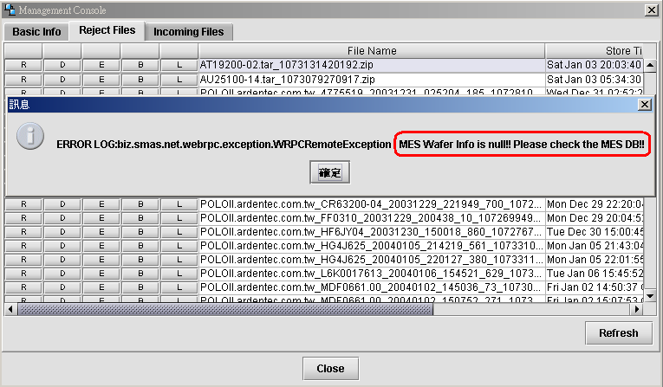
UPLOAD ERROR HANDLE
-- MES INFO. Not Found (LR) --
ERROR LOG: ...MES Wafer Info is null!! Please check the MES DB!! (for LR)
原因:未過帳或過帳時間與Wafer測試時間不一致
方式:ENG模式上傳 (或是參照編輯.BinSum檔案)

Slide 44
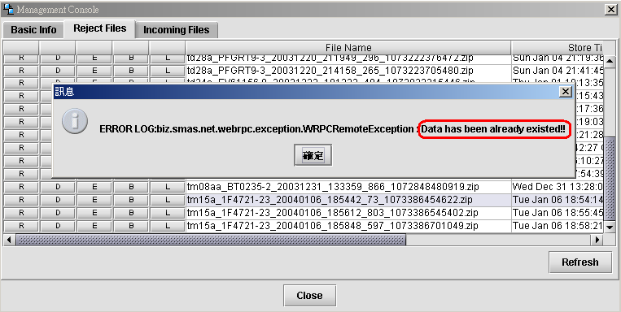
UPLOAD ERROR HANDLE
-- Data has been existed!! --
ERROR LOG: ...Data has been already existed!!
原因:資料已經上傳至TPAS系統;若仍然看不到Data, 請使用TPAS系統裡的Data Management Tool看看是否CRC未算完.
注意:請保留此類型檔案,系統人員會定期monitor,謝謝

Slide 45
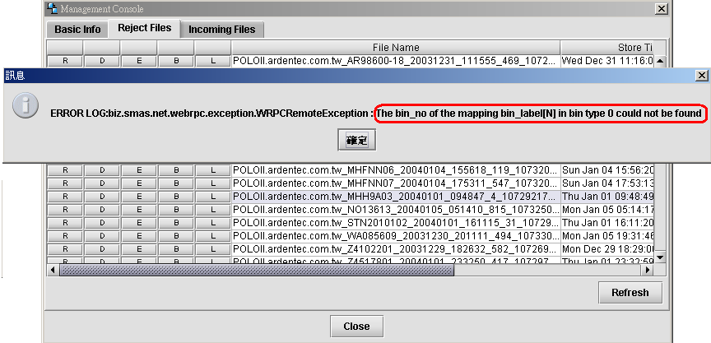
UPLOAD ERROR HANDLE
-- Bin_no of bin_label ERROR --
ERROR LOG: ...The bin_no of the mapping bin_label[N] in bin type 0 could not be found.
原因:Bin_label N 沒有在bin_def裡面定義
方式:去TPAS的prod info裡面的bin def定義新增bin label

Slide 46
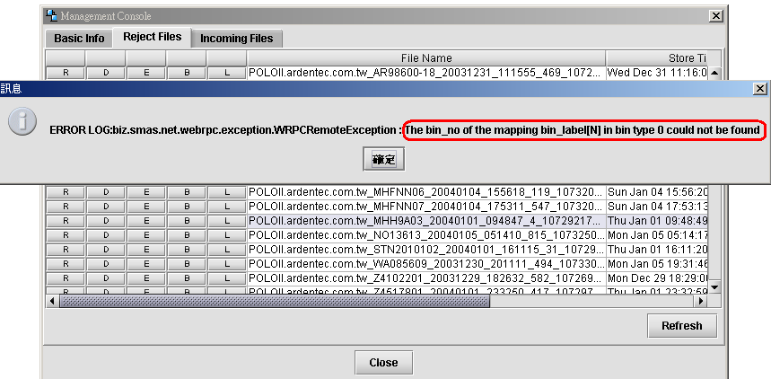
UPLOAD ERROR HANDLE
-- Unmatched shape!! --
ERROR LOG: ...Unmatched shape!!(30,22)
原因:test map 座標為x=30,y=22的die 在 standard wafer map 沒定義到
方式:去TPAS的standard wafer map檢查定義

Slide 47
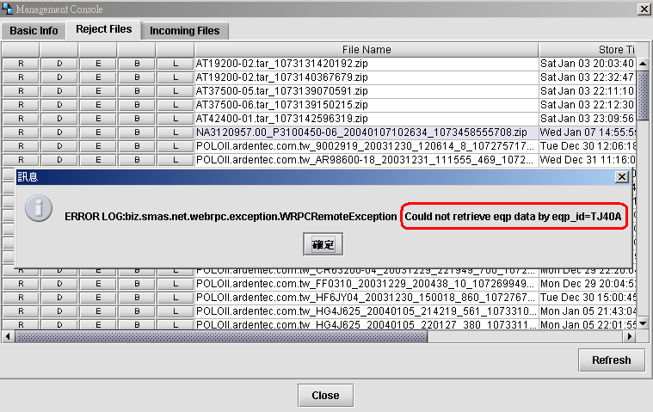
UPLOAD ERROR HANDLE
-- EQP_ID ERROR --
ERROR LOG: ... Could not retreieve eqp data by eqp_id=TJ40A
原因:EQP Basic Record沒有建置這一個eqpid,為新機台或資料曾被刪除
方式:去TPAS的EQP Basic Record新增機台ID

Slide 48
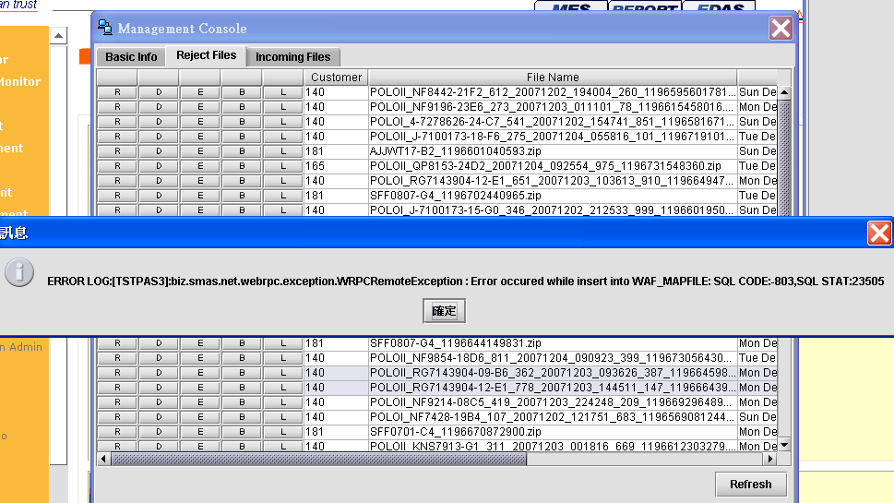
UPLOAD ERROR HANDLE
-- Insert Table ERROR --
ERROR LOG: ...Error occured while insert into WAF_MAPFILE
原因:處理的transaction過多造成table DB timeout
方式: Delete Record from WAF_MAPFILE by CIM

Slide 49
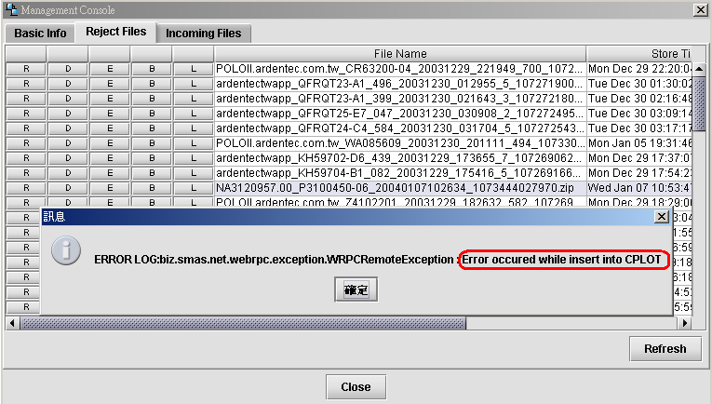
UPLOAD ERROR HANDLE
-- Insert Table ERROR(2) --
ERROR LOG: ...Error occured while insert into CPLOT
原因:處理的transaction過多造成table DB timeout
方式:請按R鍵重新上傳
Table: CP_SUBLOT, WAF_DATA1, WAF_DATA2, or STD_MAPFILE

Slide 50
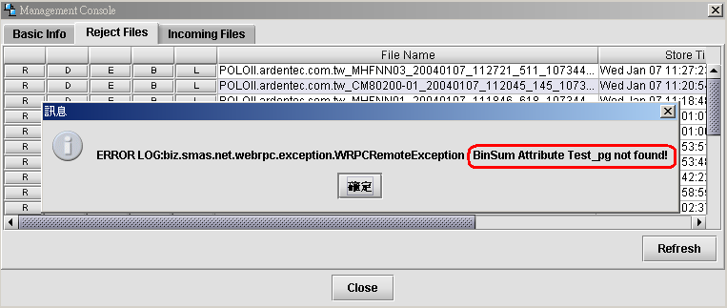
UPLOAD ERROR HANDLE
-- BinSum Attribute ERROR --
ERROR LOG: ... BinSum Attribute Test_pg not found!
處理Raw file將data轉換成系統內部相容模式的時候發生問題
檔案可由B鍵連結檔案附檔名為 .BINSUM並展開內容

Slide 51
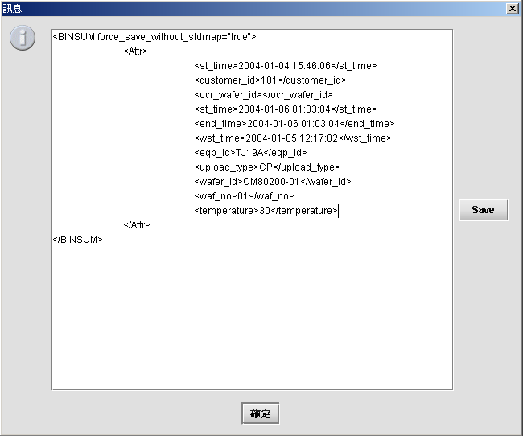
UPLOAD ERROR HANDLE
-- BinSum Attribute (2) --
注意到Test_pg(即test program)並不存在

Slide 52
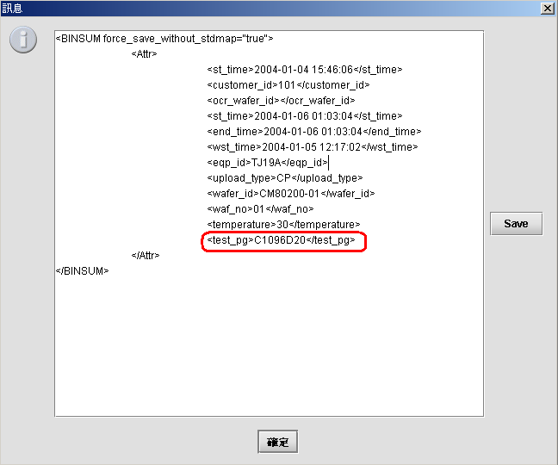
UPLOAD ERROR HANDLE
-- BinSum Attribute(3) --
新增名字為test_pg的tag: <test_pg></test_pg>
SAVE過後即按R鍵重新上傳

Slide 53
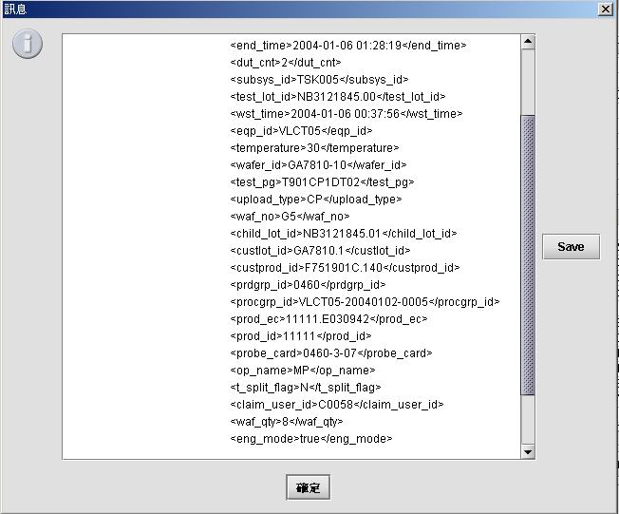
UPLOAD ERROR HANDLE
-- BinSum Attribute Usage (1) --
雖然排的位子不固定,但仍可注意到沒有tag<lot_id></lot_id>

Slide 54
Reference
-- CP/FT/LR-UploadBean --
Main: createUploadData()
insertIntoWAF_DATA2()
insertIntoCPLOT()
insertIntoCPSUBLOT()
insertWAF_MAPFile()
insertWAF_DATA1()
Main: CPLotCrcManagementBean
storeCpLotMon()
Main: CPCrcManagementBean
crcResultData
DUWafToSTMStoring()
DUWafToMonStoring()

Slide 55
Reference
-- CPView/CpDataModifyBean --
Main: removeWafer()
removeCpSublot()
removeCplot()
removeCpLotmon()
removeWafData1()
removeWafData2()
Related Table:
cp_lot
cp_sublot
cp_lotmon
waf_mapfile
waf_2stm
waf_mon
waf_crc
waf_data2
waf_data1**
removeWafCrc()
removeWafMon()
removeWaf2stm()

Slide 56
TIF for Upload
Tester Local Path
Windows=> LocalDrive:\EQPName\Utls\Wintif.exe
Unix Path=>
(1) J995:/data1/mes/tif
(2) ESI9350:/customer/files/bin/tif
(3) Ohters:/home/prjmgr/tif
CVS Path=> CProgram
ISO27K Backup Path=> \\cvs\publics\TPAS Beta Version\UploadClient\LastVersion\TIF
IPStor Path (Only for reference)
=> IPStor:/EQPName/CPFTOI/UTLS/Wintif.exe

Slide 57
WaferTrans for Upload
Tester Local Path
Windows=> LocalDrive:\EQPName\Utls\JWafTrans.exe
Unix Path=> /home/prjmgr/Waf_Trans
CVS Path=> CProgram
ISO27K Backup Path=> \\cvs\publics\TPAS Beta Version\UploadClient\LastVersion\WaferTrans\
IPStor Path (Only for reference)
=> IPStor:/cim/TPAS/EQPNameWafTrans.exe

Slide 58
Q & A
EXERCISE

